Slide 1
Project Java and Web Development (DLBCSPJWD01)
GitHub link: https://github.com/gdesiato/DLBCSPJWD01
Student: GIUSEPPE DESIATO

Slide 2
Rock Albums Web App
Purpose:
The Rock Albums web application is intended for rock music enthusiasts. It serves as a platform where users can discover, explore, learn and interact with their favorite rock albums.
The application targets music lovers, collectors, and fans with a specific interest in rock music.
1

Slide 3
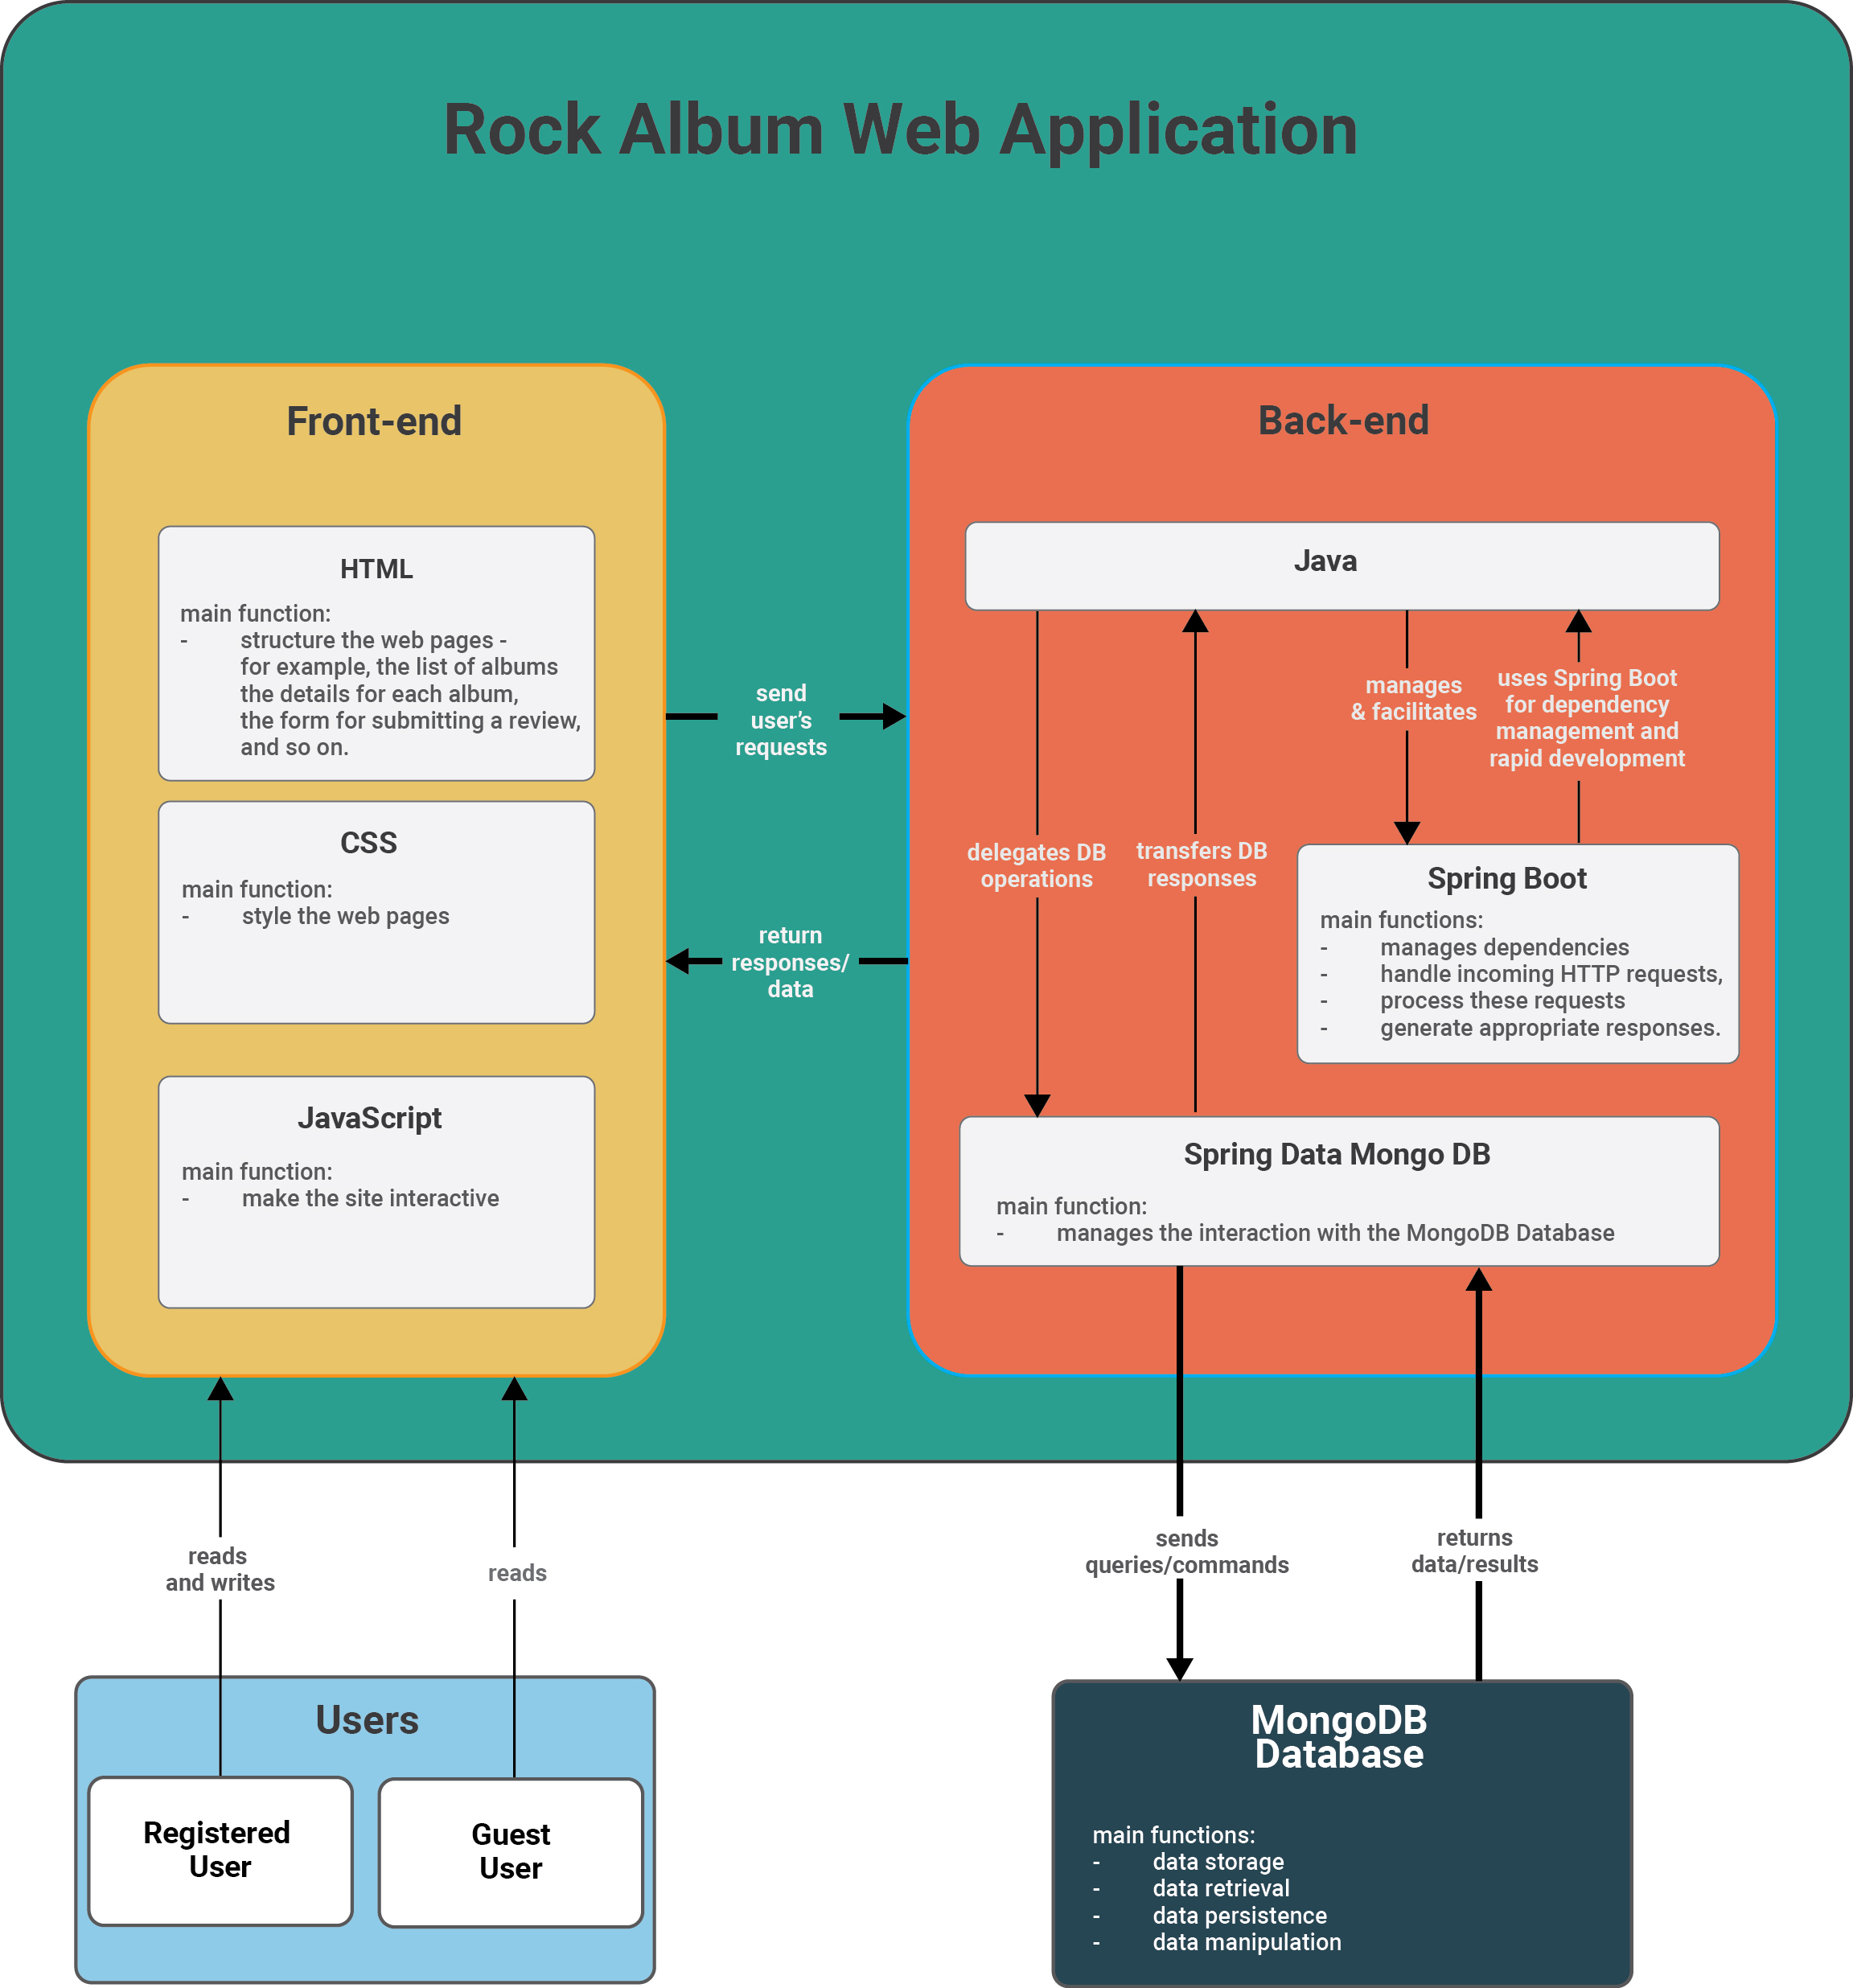
Architecture
Diagram
2

Slide 4
Overview of Technology choice
Front-end Technologies:
HTML, CSS, and JavaScript: These fundamental web technologies will be used for structuring and styling the application's interface and implementing dynamic functionalities.
Dynamic behavior:
The script.js file is primarily handling the submission of a review and rating for an album. Rather than submitting the form in the traditional way, which would involve a full page refresh, this script captures the form submission event, prevents the default behavior, and instead sends the form data to the server using the Fetch API - a modern, promise-based mechanism to make HTTP requests from browsers.After the server processes the review and rating and responds, the script then reloads the page so that the user can see their newly added review.
The search.js file is managing a real-time search feature. As the user types into the search box, it sends a request to the server with the current contents of the search box.
Back-end Technologies:
The application's back-end will handle data storage, processing, and communication with the front-end. The chosen technologies include:
Java will serve as the core language for back-end development.
Spring Boot will be used to facilitate rapid development, dependency management, and RESTful API implementation.
Spring Data MongoDB: This library will provide seamless integration between the Spring Boot application and the MongoDB database, simplifying data access and manipulation.
Database:
MongoDB will be used to store and retrieve album information, reviews, and ratings. In addition to that, the database will be used to store all the information about registered users, such as usernames, passwords, and profile information.
3

Slide 5
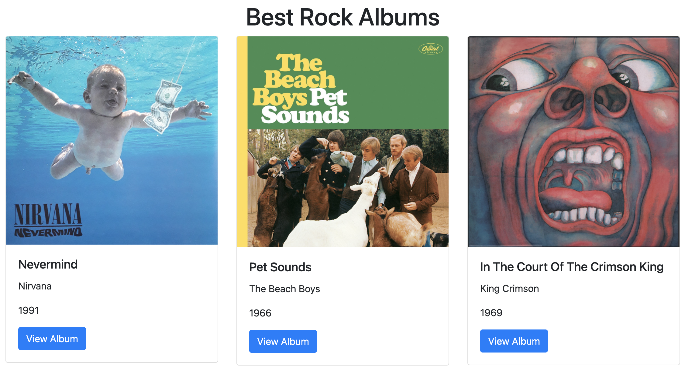
Home page
Home
Here the album stored in the database are shown using this card format.
4

Slide 6
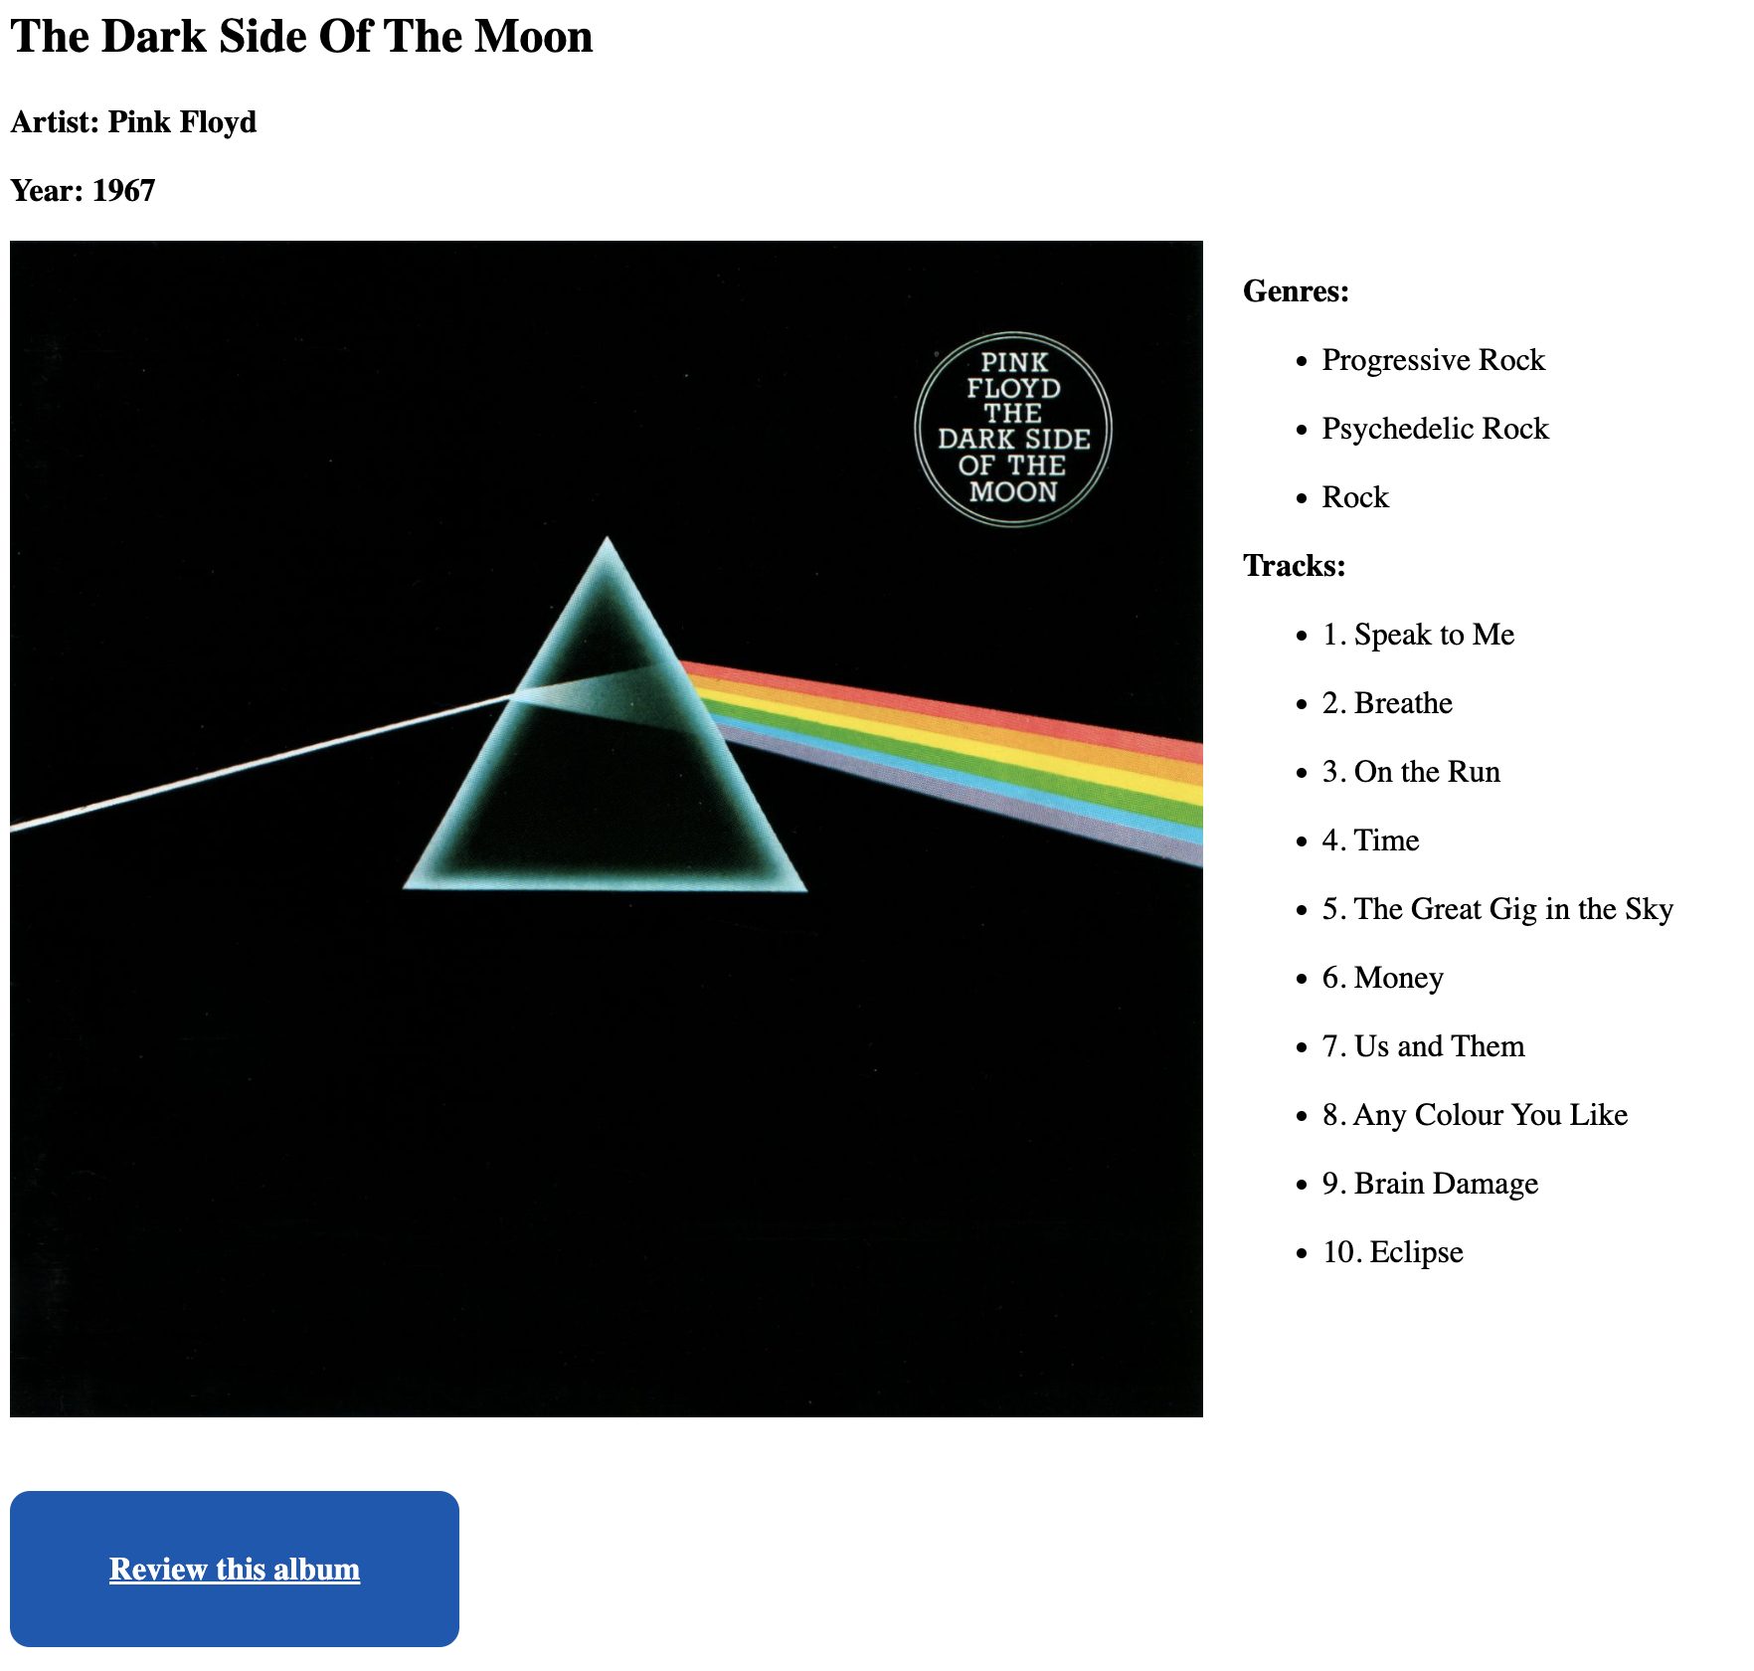
Album page
Album Detail
This page displays the information about the album, and allows the users to leave a review.
5

Slide 7
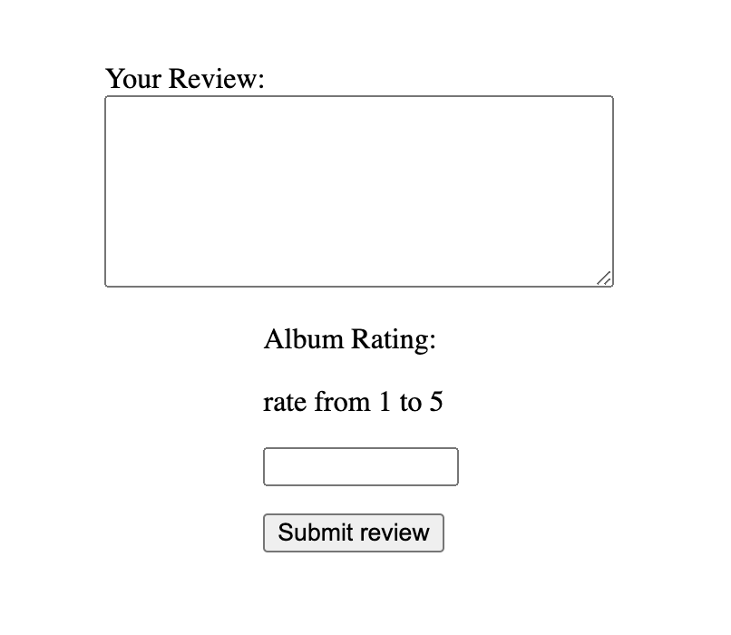
Review page
Review
Simple page with two fields.
One for leaving the review comment and one for giving to the album a numerical rating from 1 to 5.
6

Slide 8
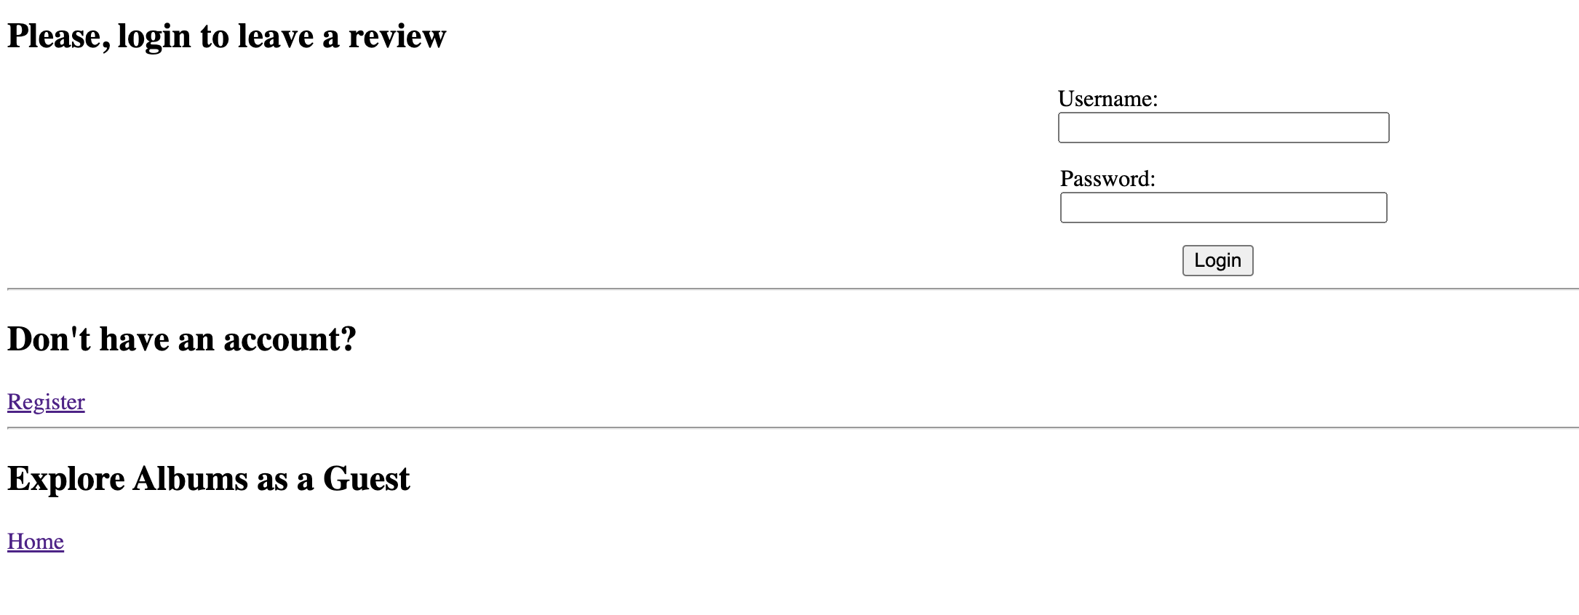
Login or Registration page
Login
The login page will pop up in case a guest is trying to leave a review. In order to leave a review the user needs to be authenticated.
7

Slide 9
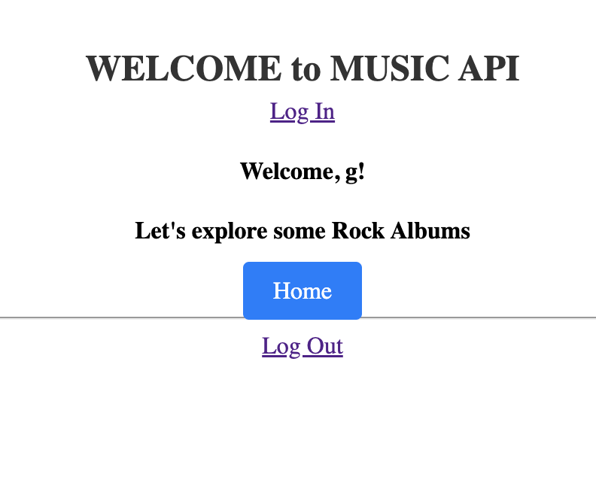
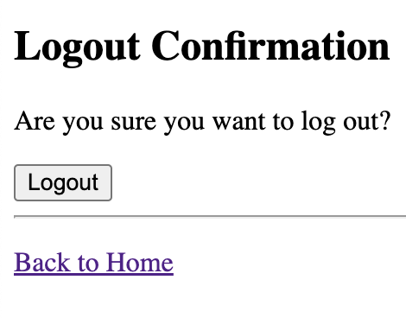
Confirmation pages
Confirmation
Once the user is registered and logs in, this is the page that appears welcoming the user, using the username.
Logout
Once the user clicks on the logout button, is prompted with this page that asks for a confirmation of the logout action.
8

Slide 10
Modification compared to Phase 1
Guest and User
The main aspect that was modified between the Conception Phase and the Development Phase was the specification of what a Guest can do and what a User can do. While before there was no specific idea proposed in relation to user authentication, now the authentication system has been implemented.
Guests and authenticated Users can browse the collection of rock albums and can access detailed information about each album, including artist, title, release year, genres, and tracks.
However only Users can submit reviews to be displayed under the albums, in the Album specific page.
10

Slide 11
